Slide 1


ARTIK Gateway Modules
Wei Xiao
Oct 2nd, 2018
Confidential

Slide 2
Agenda
ARTIK Gateway Module Overview
ARTIK Gateway Module Use Cases
ARTIK Gateway Module Software Stack
ARTIK Gateway Module Development
ARTIK Gateway Module Security

Slide 3

ARTIK Gateway Module Overview
Confidential

Slide 4
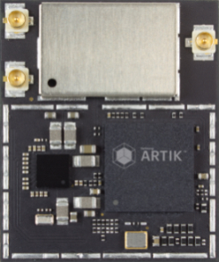
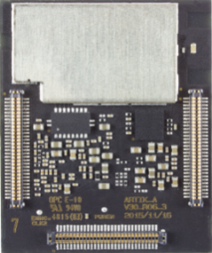
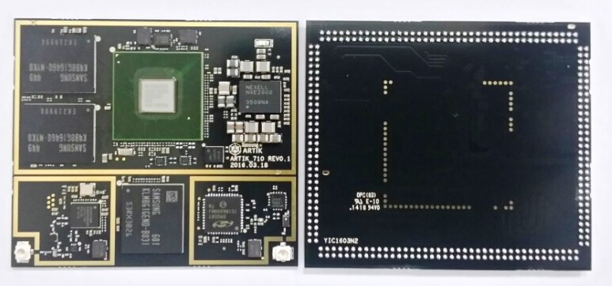
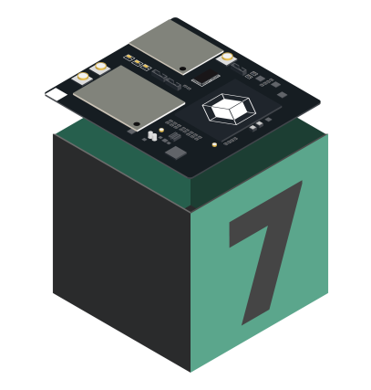
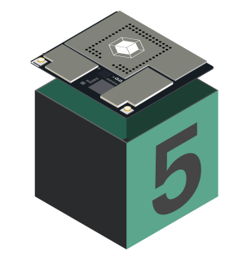
ARTIK High-end module
30mm
520
25mm
49mm
Top view
Bottom view
710
36mm
49mm
710s
Top view
Bottom view
530
36mm
530s
Top view
Bottom view

Slide 5




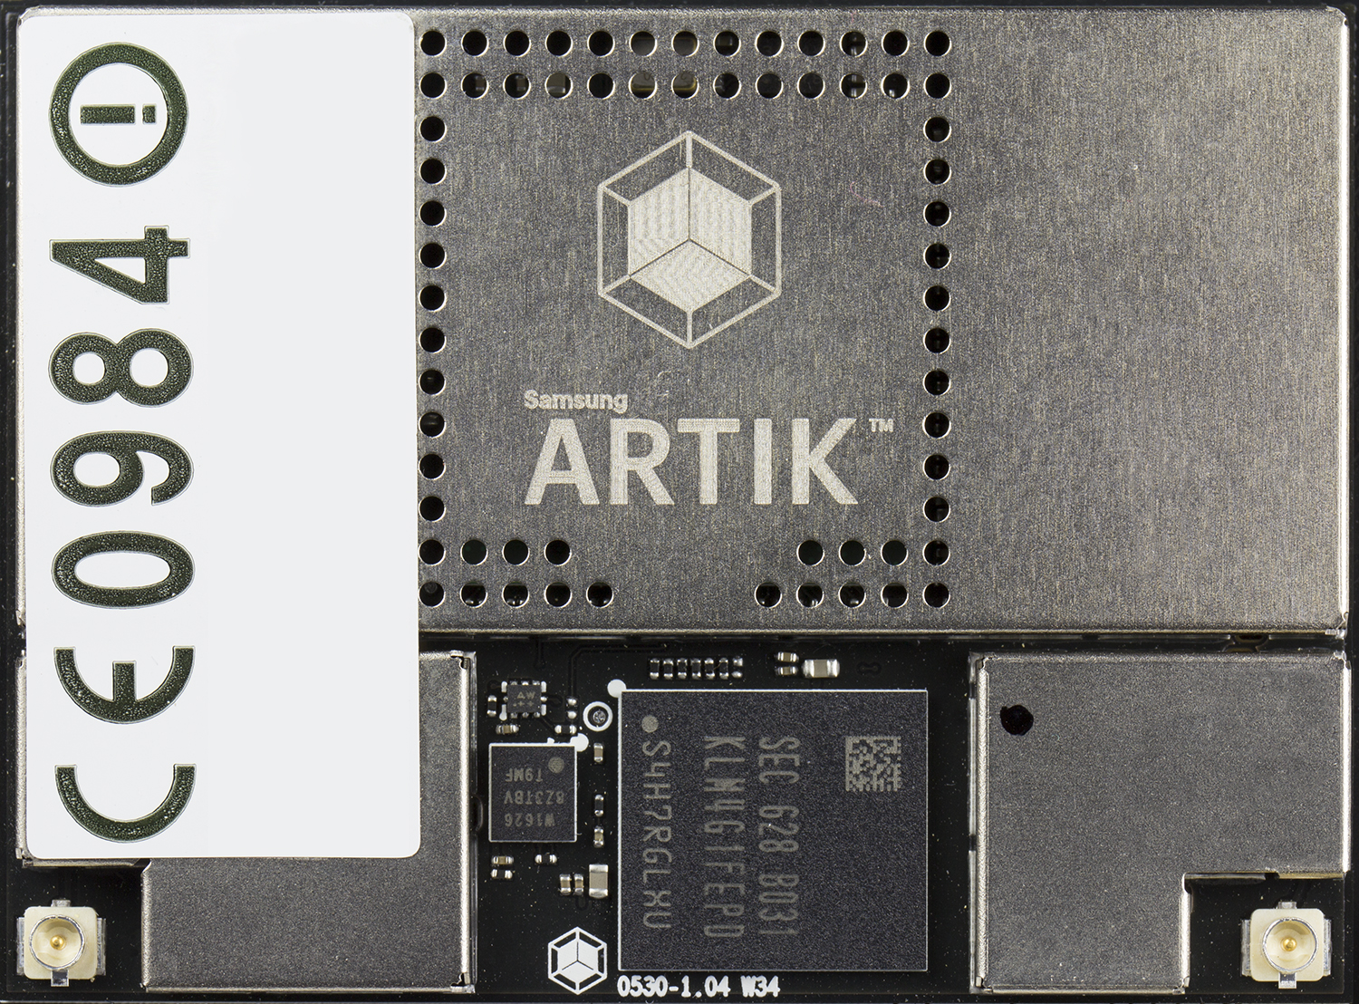
Samsung ARTIK™ 530/530s (512 MB, 1 GB) mid-range gateway Secure, fully-integrated IoT solution
Processor | CPU: 4x ARM® Cortex® A9 @ 1.2 GHz GPU: 3D graphics accelerator
Memory | DRAM: 512 MB/1 GB DDR3 Flash: 4 GB eMMC v4.5
Multimedia | Camera I/F: 4-lane MIPI CSI up to 5MP Display: 4-lane MIPI DSI, HDMI 1.4 a or LVDS (1280 x 720 @ 60 fps) Audio: 2x I2S audio input/output
Connectivity | WLAN (Wi-Fi): IEEE 802.11 b/g/n single-band SISO Bluetooth: 4.2+ Smart 802.15.4: Zigbee, Thread Ethernet: 10/100/1000 Base-T MAC (external PHY required)
Security | Secure element, EAL Level 5, unique device certificate and keys, PKI with mutual authentication to cloud, hardware crypto engine; secure boot*, KMS*, TEE*, *S-modules
I/O | GPIO, UART, I2C, SPI, USB Host, USB OTG, HSIC, ADC, PWM, I2S, JTAG
Temperature range | -25° to 85° (°C)
Size | 36 mm W x 49 mm H x 3.4 mm D
Industrial and home gateways
Voice-controlled speakers
Building zone controllers
Display-based healthcare monitors

Slide 6
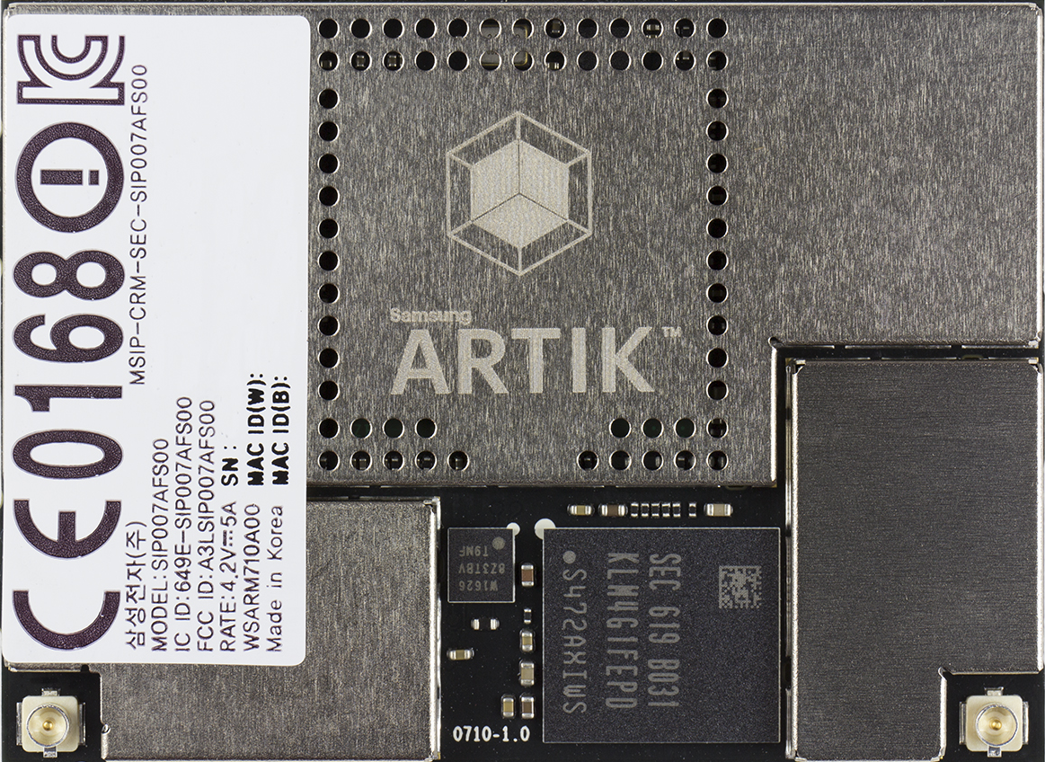
Samsung ARTIK™ 710/710s high-end gateway Secure, fully-integrated IoT solution
Processor | CPU: 8x ARM® Cortex® A53 @ 1.4 GHz GPU: 3D graphics accelerator
Memory | DRAM: 1 GB DDR3 @ 800 MHz Flash: 4 GB eMMC v4.5
Multimedia | Camera I/F: 4-lane MIPI CSI Display: 4-lane MIPI DSI up to FHD@24 bpp, LVDS, HDMI v1.4 Audio: I²S audio interface
Connectivity | WLAN (Wi-Fi): IEEE 802.11 b/g/n/ac Bluetooth: 4.1+ Smart 802.15.4: Zigbee, Thread Ethernet: 10/100/1000 Base-T MAC (external PHY required)
Security | Secure element, EAL Level 5, unique device certificate and keys, PKI with mutual authentication to cloud, hardware crypto engine; secure boot*, KMS*, TEE*, *S-modules
I/O | GPIO, I²C, I²S, SPI, UART, PWM, SDIO, USB 2.0, JTAG, analog input
Temperature range | -25° to 85° (°C)
Size | 36 mm W x 49 mm H x 3.4 mm D
High-end gateways
Cameras
Human-machine interface
Machine learning

Slide 7
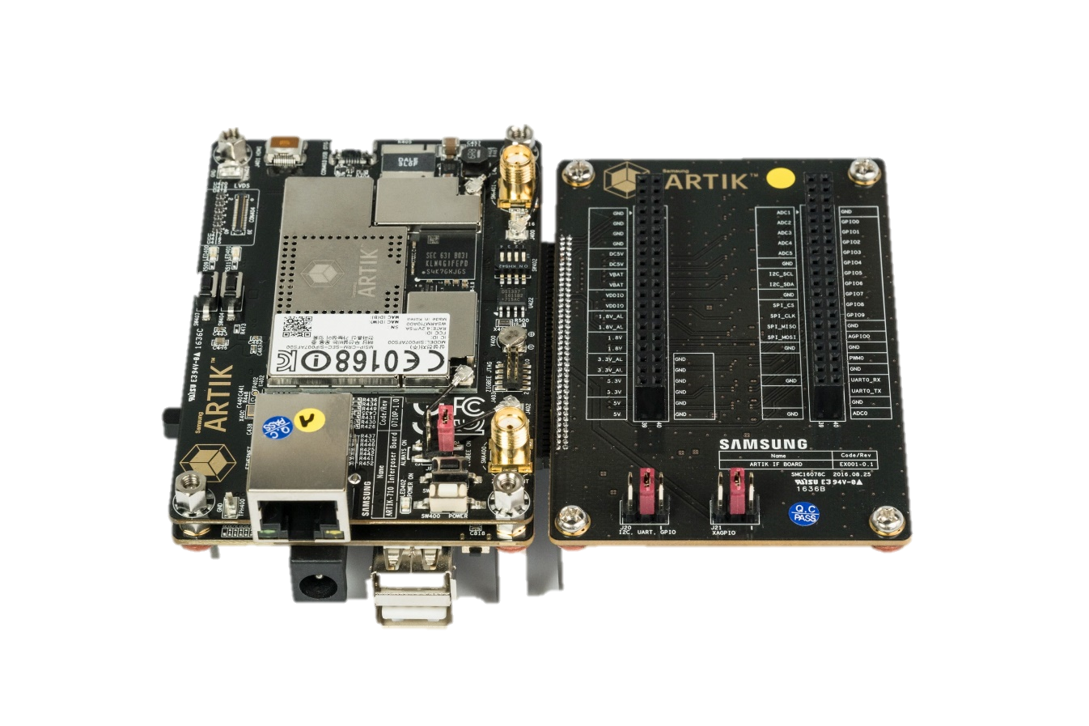
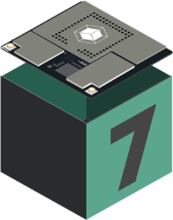
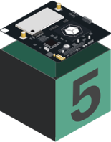
ARTIK High-end module development board
Interposer Board
ARTIK 530/710 Module
Interface (IF) Board
Platform board

Slide 8
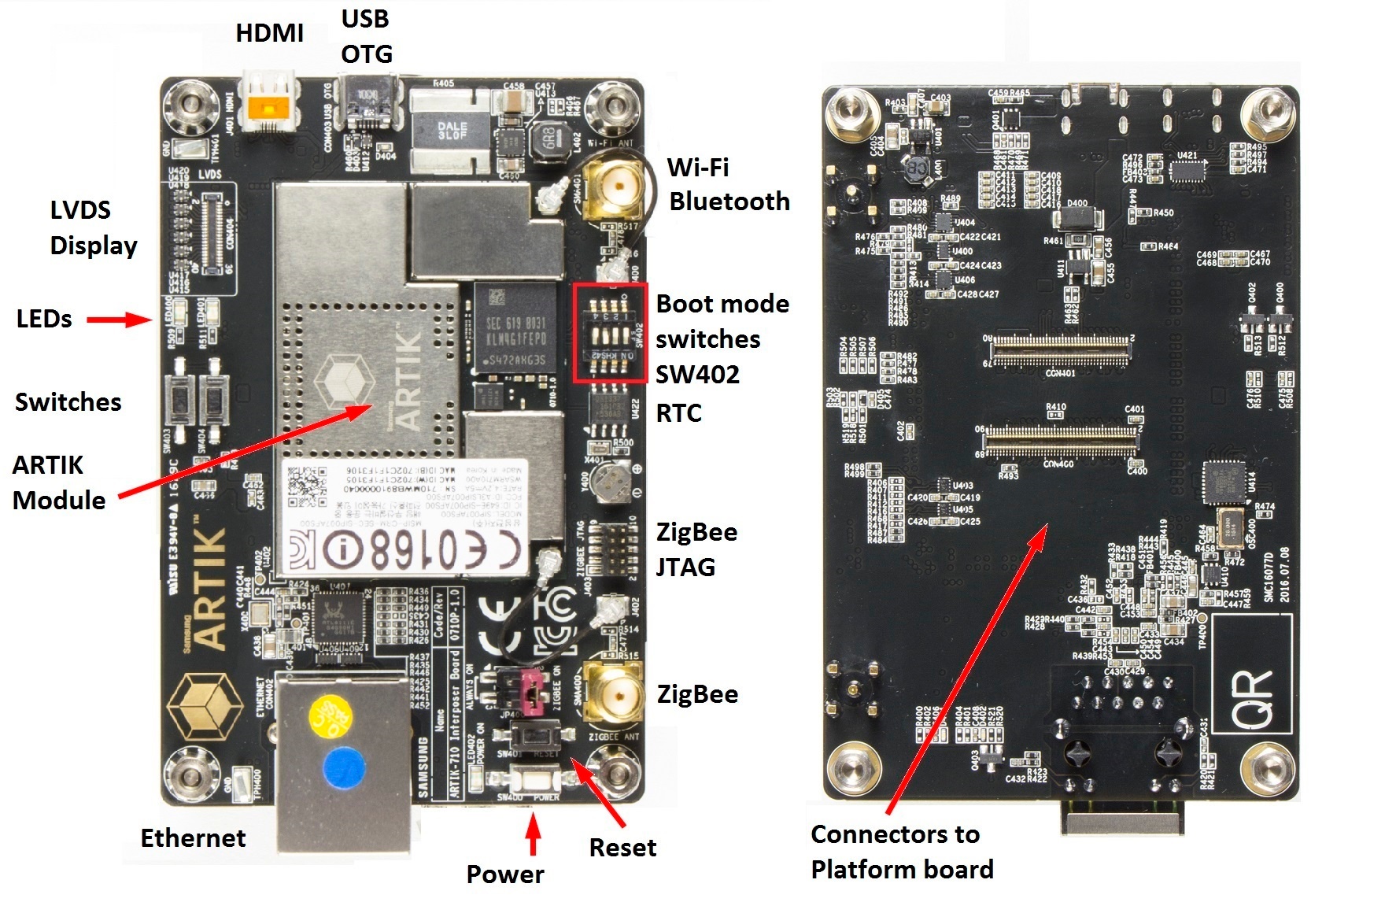
ARTIK High-End Module Interposer Board

Slide 9
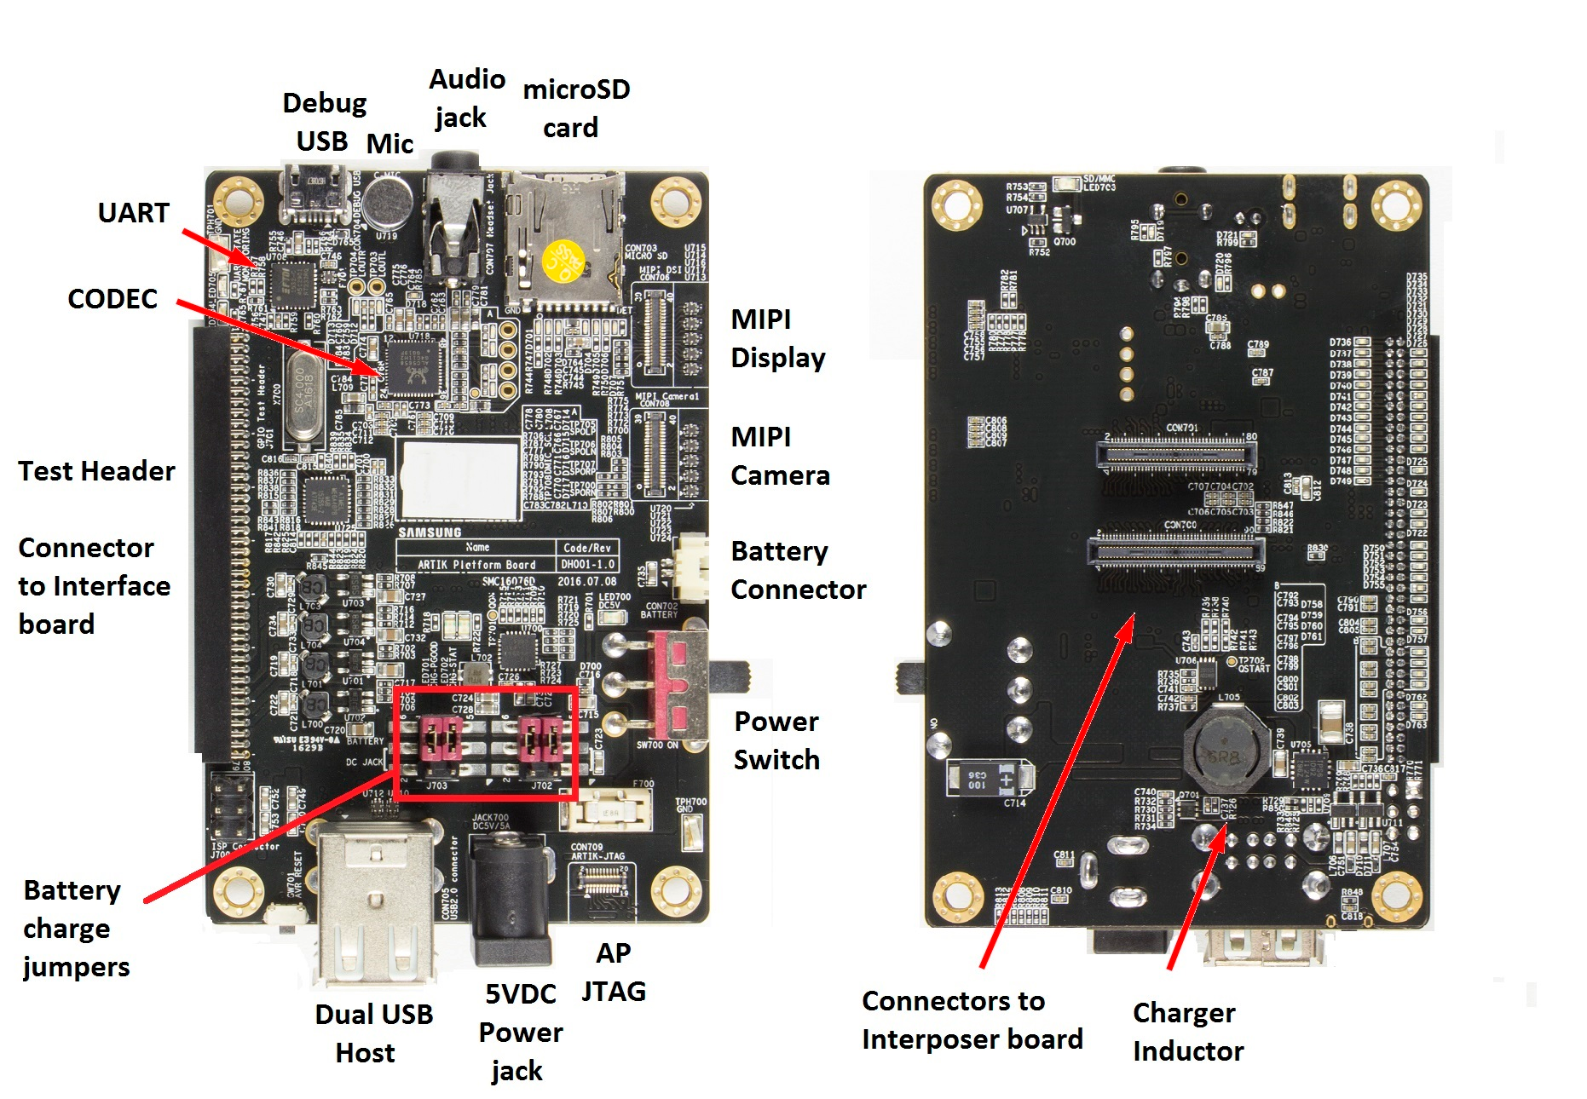
ARTIK Gateway Module Platform Board

Slide 10
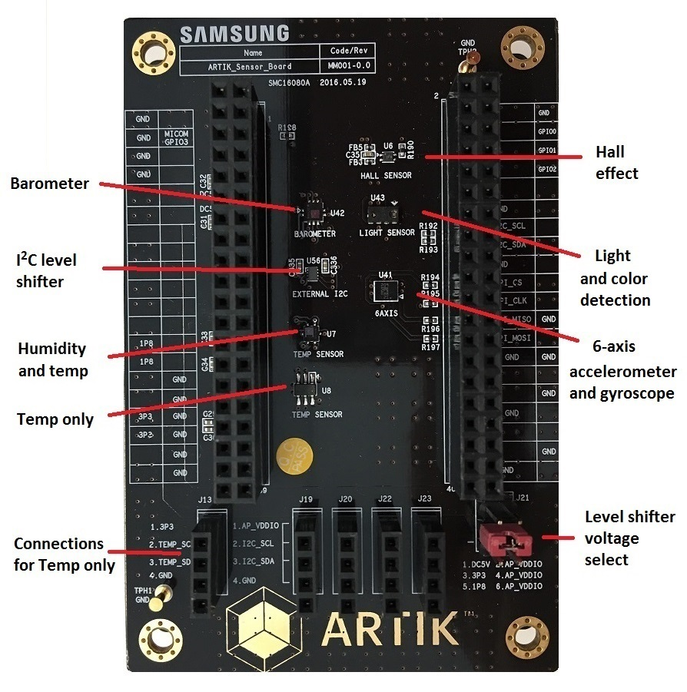
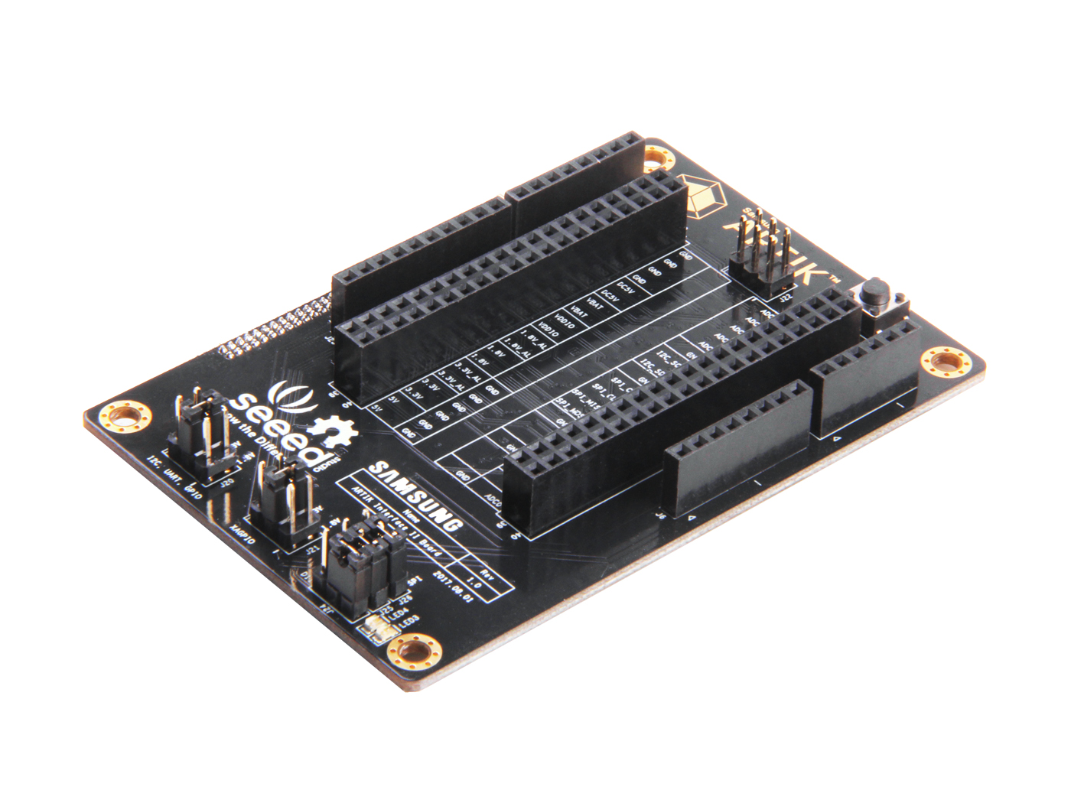
ARTIK Gateway Module Expansion Boards
Interface Board
Interface Board II
Sensor Board

Slide 11
ARTIK Gateway Module Use Case
Confidential

Slide 12
RushUp Kitra GTI Leverage IoT with industrial I/O, sensors, and LTE
Building automation, manufacturing, remote asset management: connect easily to existing infrastructure with analog I/O
Retrofit in minutes: Multiple analog I/O for external sensors such as current, temperature and humidity, relay and contact; digital input for contact switches; support for Mod bus
Based on ARTIK 710s: includes 4G LTE, GNSS, for long range connectivity and location; security includes secure boot, secure OS, secure storage, secure communication, KMS, PKI
Embedded sensors: temperature, accelerometer, gyro & microphone
Cloud ready: ARTIK cloud services SDK pre-installed, works with Azeti asset monitoring or PTC Thingworx

Slide 13
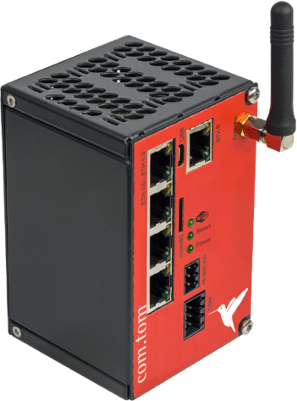
Beck CTS 140.K Integrate existing industrial equipment into the IoT
Beck’s long experience in the industrial market makes IoT easy. The CTS 140.K features a wide range of field bus protocols, WIFI, BT, and cellular
Cloud native: use Beck’s cloud broker or ARTIK cloud services
On premise: connect to a local server and manage via a simple Web interface using PC, tablet or smartphone
Customize: Add/remove RS485, Ethernet, I/O options; Beck’s experience provides for smooth integration
Security features: ARTIK 710s provides secure boot, secure OS, secure storage, secure communication, KMS, PKI
Ecosystem
Notes:
Beck has long experience providing typical industrial field bus protocols such as Modbus, Profinet, profibus, Mbus, CAN, etc.
Customization is available on request

Slide 14


Customer Use Cases
Legrand: Global residential and commercial digital building infrastructure
Challenge: Transform product line to meet new connected digital mkt requirements. Fast time to mkt. Interoperability.
Products: ARTIK 530s, 710s secure system-on-modules, ARTIK cloud services
Why ARTIK? Reduced product development time. Built-in software eliminated internal dev skills roadblock. Security allows them to meet new customer reqs. Interoperabilty expands switch capabilities, helped them get POC with Marriott “Room of the Future”.
NDA Customer: Factory automation provider
Challenge: Retrofit customer OT to meet requirements for Industrie 4.0, enable access to data and create digital twins for more efficient operations. Ensure secure operations.
Products: ARTIK 530s secure system-on-module, ARTIK partner PTC
Why ARTIK? Secure gateway solution for their industrial gateway with access to local sensors, ability to do local processing and edge node management, application to view data via integration with PTC Thingworx front end application.

Slide 15



Customer Use Cases
NDA Customer: On-body multimedia hub for first responders
Challenge: Performance and capabilities including high-resolution video. Connectivity with other on-body sensors. Reliability.
Products: ARTIK 710s secure system-on-module, evaluating cloud services for data capture and management
Why ARTIK? Best performance and value relative to cost. Secure data storage and communications.
Samsung Device Solutions
Challenge: Quickly develop a cost affordable android-based multi-dwelling control panel that runs video.
Products: ARTIK 7x secure system-on-module, ARTIK cloud services on SmartThings Cloud
Why ARTIK? No product on the market which meets their specs for Android/video and security. Ability to customize 710 to meet their high volume requirements. Interoperability and access to additional service with ARTIK cloud services on SmartThings Cloud. Built-in security.

Slide 16





Customer Use Cases
NDA Customer: Assisted Living platform to provide status and data without being intrusive
Challenge: Started with Intel Edision, which EOLd the product. Needed a fast replacement, with minimal development time, BT beacon tracking, WiFi, video and sensor inputs.
Products: ARTIK 530 system-on-module, evaluating ARTIK cloud services
Why ARTIK? Were able to quickly replace the module with factory-ready, pre-certified product, and minimize lost time to market with an added bonus - ability to access ARTIK integrated cloud services.
NDA Customer: Telecommunications company providing low-cost high speed data access platform and base station for homes
Challenge: Needed high end processor capable of complex operations for edge computing.
Product: ARTIK 710 system-on-module
Why ARTIK? Provides price performance to meet their requirements. Allowed them to quickly “prove” their product with ability to quickly scale up on production-ready product.

Slide 17
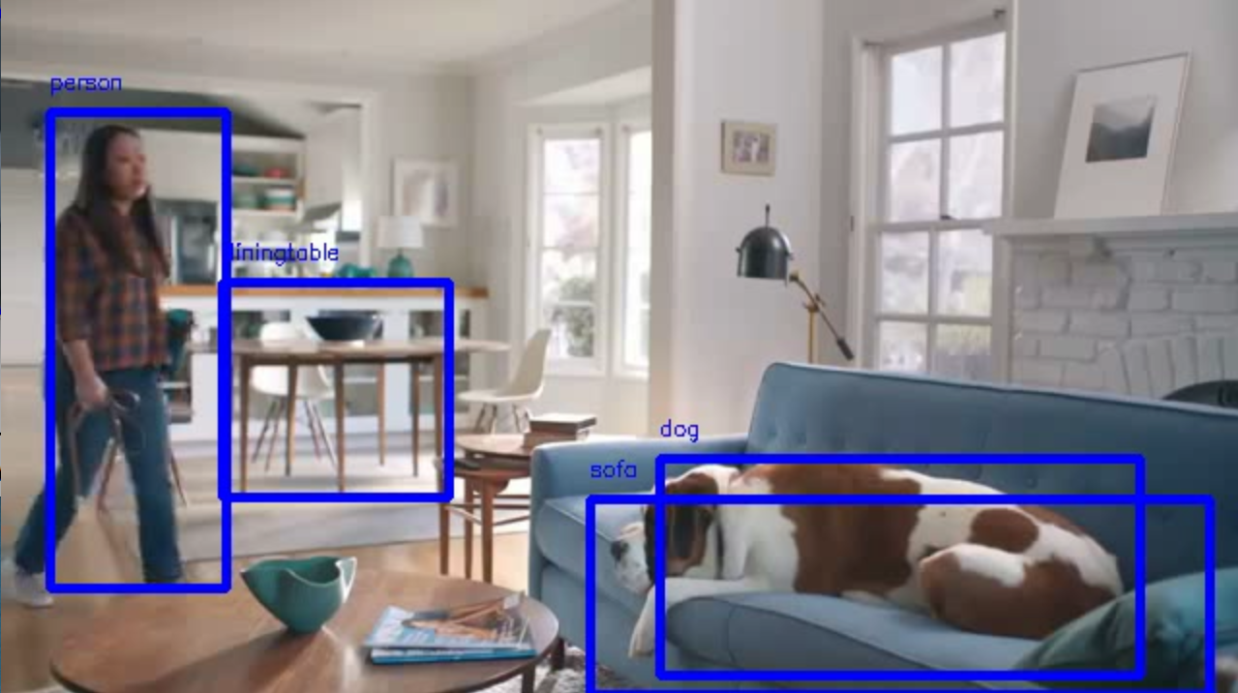
Machine Learning Inference ARTIK 5x/7x
Run Machine Learning Inference on ARTIK gateway devices
Use case: Smart Factory, Smart Building etc.
Hardware: ARTIK 5x/7x
Software: Tensorflow (Lite);
AWS Greengrass ML Inference;

Slide 18
ARTIK Gateway Module Product Details
Confidential

Slide 19







Product Details
Multimedia
Radio Connectivity
Processor and Memory
Peripheral Interfaces
Security
Power MGT and Analog Blocks

Slide 20
Product Details – Processor and Memory
Multimedia
Radio Connectivity
Processor and Memory
Peripheral Interfaces
ARM Multi Core Processor
SD CARD
DRAM
FLASH
Security
Power MGT and Analog Blocks

Slide 21
Radio Connectivity
Radio | Range | Data Rate | 520 | 530 | 710
BLE | 50m | <1Mbps | ✓ | ✓ | ✓
BT | 30m | 1-3Mbps | ✓ | ✓ | ✓
ZigBee | 10-100m | 10-100Kbps | ✓ | ✓ | ✓
Thread | N/A | 10-100Kbps | ✓ | ✓ | ✓
Wi-Fi | ~50m | 10-100Mbps | ✓ | ✓ | ✓
Ethernet |  |  | ✓ | ✓ | ✓
*Z-wave and Sigfox chip set is on 520 development boards
Notes:
Long-Range Connectivity

Slide 22
Peripheral Interfaces + Power MGT & Analog blocks
 |  | 520 | 530 | 710
Peripheral Interfaces | I2C | 6 | 3 | 3
 | SPI | 2 | 2 | 2
 | GPIO | 100 | 107 | 108
 | UART | 2 | 3 | 3
 | USB | USB 2.0* | USB 2.0 | USB 2.0
Analog and Power MGT | ADC | 2 | 6 | 6
 | PWM | 2 | 2 | 2
 | PMIC | ✓ | ✓ | ✓
*USB device mode only for 520, rest of the module is both device and host mode.
Notes:
I2C supports 127 devices; 7-bit address; 2^7 -1
SPI high speed, big volume data;
GPIO: mux;
ADC: resolution;
PMIC: data sheet.
PWM: Servo motor; step motor; light dimmer

Slide 23
Product Details - Multimedia
 | 520 | 530 | 710
I2S | 1x | 2x | 2x
HDMI + audio | n/a | 1080p @ 60fps | 1080p @ 60fps
MIPI – DSI | 2-lane 540p @ 24bpp | 4-lane 1080p @ 60fps | 4-lane 1200p @ 24bpp
MIPI – CSI | 2-lane 3MP @ 30fps | 4-lane 1080p @ 30fps | 4-lane 1080p @ 30fps
LVDS | n/a | 720p @ 60fps | 720p @ 60fps
Notes:
I2S audio data interface (on top of UART, I2C, SPI etc.) data transfer;
Playback: 1080p@60fps;
Product details.
LVDS -
MIPI camera input issue: No raw input. Can not bypass video input pipeline.
MIPI DSI(Display Serial Interface). CSI(Camera Serial Interface), LVDS(Low Voltage Differential Signaling)
For Customer PoC we recommend HDMI for Display and USB for Camera. 520 is the only exception which does not have HDMI.
Gen1 was SW accelerated while Gen2 is HW accelerated. HW acceleration is faster, better performance and lower power.
Top tier customers (especially those with custom display and camera devices) have the in house expertise to develop their own device driver(s). Their requirements from ARTIK:
Processor datasheet – register settings, Pin configurations
Pin Mapping from SoC to ARTIK module
PCB guidelines

Slide 24
ARTIK Gateway Module Software Stack
Confidential

Slide 25

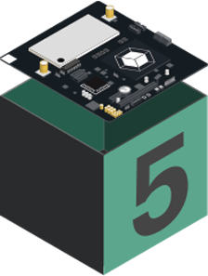
ARTIK Gateway Software Stack
Application
ARTIK API etc.
Root FS
Kernel
Hardware
Notes:
Linux® kernel
U-Boot (Boot Loader)
RootFS (Root File System)

Slide 26
U-Boot and Linux Kernel Architecture
U-Boot
Linux Kernel
Core
Core
Board Support Package & Driver
Board Support Package & Driver
Power Management
File System
ARTIK Module BSP
USB
Sound
GPU
SPL
Scheduler
Block Driver
Video Codec
Wi-Fi/BT
KMS/DRM
MIPI-DSI
U-boot executable
Network
Memory Management
Camera I/F (MIPI CSI)
Peripherals (UART, I2C, GPIO, PWM, RTC, ….)
MMC /SDIO
HDMI
U-boot environment
Notes:
The current kernel version is 4.4, which has an end of life to Feb, 2022.
ARTIK kernel is LTS kernel(Long-time support), which supports critical bug fixes, security patches until it reaches end of life.
Ubuntu is based on Debian architecture.
Display driver, Camera Sensor Driver, Audio Driver, PHY Driver.

Slide 27
Architecture of Rootfs
Rootfs
System
Graphic
System
Multimedia
Multimedia
dbus
bash
pulseaudio
gstreamer
rpm
apt
alsa-utils
ffmpeg
systemd
libV4l2
Connectivity
Network Protocols
Libraries & Development
Notes:
Systemd is an ‘init’ daemon that can run daemons and services concurrently
Dbus is for provided as inter-service communication mechanism.

Slide 28
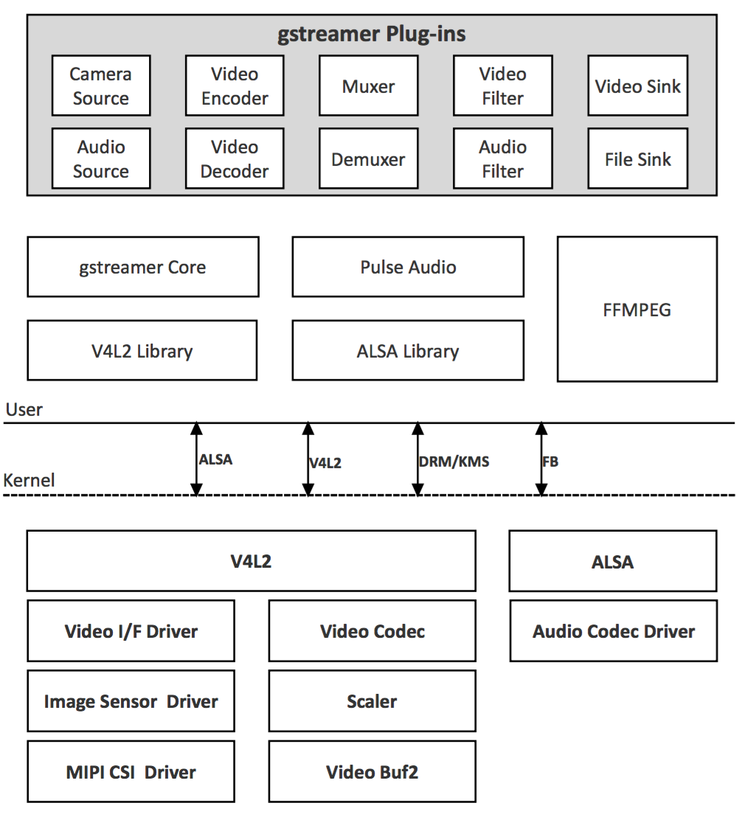
Multimedia Architecture
ALSA lib is a framework that provides software APIs for audio device drivers
Pulse Audio is based on ALSA lib for supporting sound. It runs a sound server.
Video for Linux Version 2 (V4L2) is collection of device drivers and API for supporting real-time video capture on Linux systems
Gstreamer is a pipeline-based multimedia framework that links together a wide variety of media processing system to complete complex workflows
Notes:
ALSA lib is a framework that provides a software API for audio device drivers.
Pulse Audio is based on ALSA lib for supporting sound. It runs a sound server. This is a background process that accepts sound from one or more sources(devices etc.) and redirects the sound into one of more sinks( a sound card, a remote pulse audio server).
Supports many USB webcams, TV tuners, and related devices, standardizing their output

Slide 29
Architecture of Rootfs
Rootfs
System
Multimedia
Graphic
System
Multimedia
Graphic
dbus
bash
pulseaudio
gstreamer
OpenGL
rpm
apt
alsa-utils
ffmpeg
libdrm
Mali DDK*
systemd
libV4l2
Connectivity
Networking
Libraries & Development
Connectivity
Network Protocols
Libraries & Development
wpa_supplicant
Border Router
BlueZ
connman
CoAP (libcoap)
MQTT (mosquitto)
nodejs
glib
zigbee
LWM2M (wakaama)
TLS /DTLS (OpenSSL)
glibc
python

Slide 30





Network Stack
User Applications
Networking & Application software
SSH
SSL
ZigBee Profiles
Bluetooth Profiles
LWM2M
IoTivity
MQTT-SN
Home Automation, Light Link, Healthcare, Green Pwr
DNS
Web socket
HTTP
DHCP
MQTT
mDNS
CoAP
A2DP, HID, PAN, FTP
TLS
(openSSL)
TCP
UDP
DTLS
(openSSL)
ZigBee protocol stack
Bluetooth Classic Stack
Bluetooth Smart (LE) Stack
OBEX, SPP
GATT, GAP
IPv4, IPv6
RFCOMM
ATT, SMP
Connectivity Software
Thread protocol stack
Application
Sub-layer
L2CAP
6lowPAN
Network management
HCI
Ethernet Driver
802.11 MAC
802.15.4 MAC
LMP, SCO
Low Energy Link Layer
IEEE 802.3
10/100/1000 MAC
IEEE 802.11
Dual band SISO
2.4GHz: b/g/n
5GHz: a/n/ac
IEEE 802.15.4
2.4GHz
IEEE 802.15.1
2.4GHz
Hardware
Notes:
The link layer refers to the device drivers providing access to the physical layer,
Network layer is responsible for directing packets to the destination.
Transport layer is responsible for peer-to-peer communication.
Application layer understands the data being moved.
ZigBee is one of the most popular, low-cost, low-power wireless mesh networking std on the market.Philipps, Texas Instruments, NXP etc.
Thread uses pre-existing protocols: IEEE802.15.4, 6LoWPAN(IPv6 over low power wireless personal area network) , IPv6. No application layer is defined. UDP and DTLS. Big companies like Google is behind it.

Slide 31
ARTIK SDK (5, 7 series)
User Applications
C/C++ API, Node.js add on
Software
Modules + ARTIK API
I/O
Connectivity
Multimedia
System
Cloud
GPIO
Websocket
Time
SPI
HTTP
Alarm
I2C
ADC
MQTT
Media
Log
Security
Serial
PWM
Wi-Fi / Bluetooth
Audio
Exception
Kernel
Kernel & Drivers
HW
ARTIK modules
Notes:
Take a look of the different modules included in our SDK. We are tying to provide simple and consistent APIs to support all our devices. As shown in the diagram here, we provide
APIs

Slide 32
ARTIK Gateway Module
Development
Confidential

Slide 33
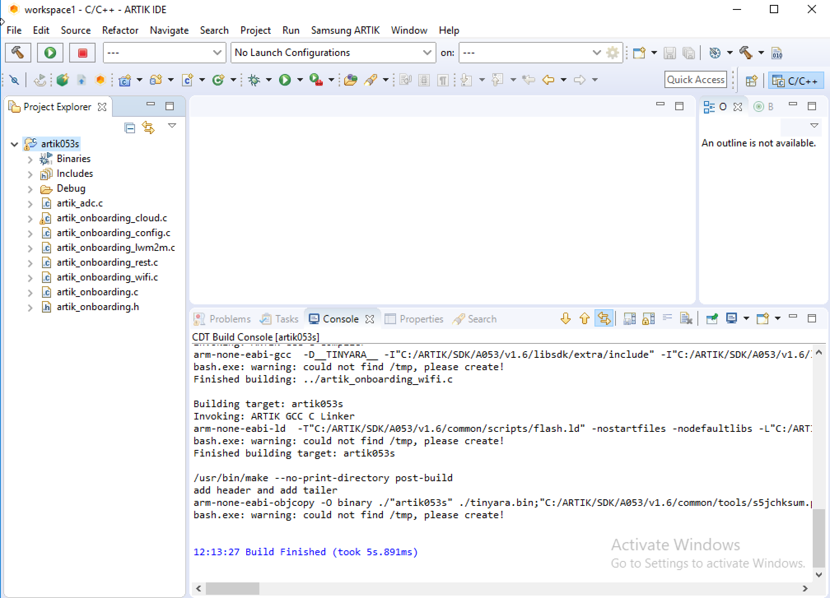

ARTIK IDE
ARTIK IDE
gcc-arm-linux-gnueabihf
(32 bit for ARTIK 5x)
and
aarch64-linux-gnu
(64 bit for ARTIK 7x)

Slide 34
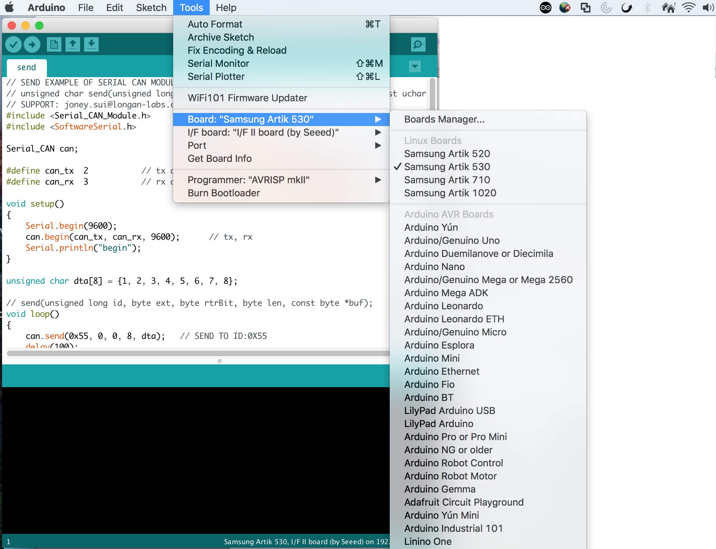
Arduino

Slide 35
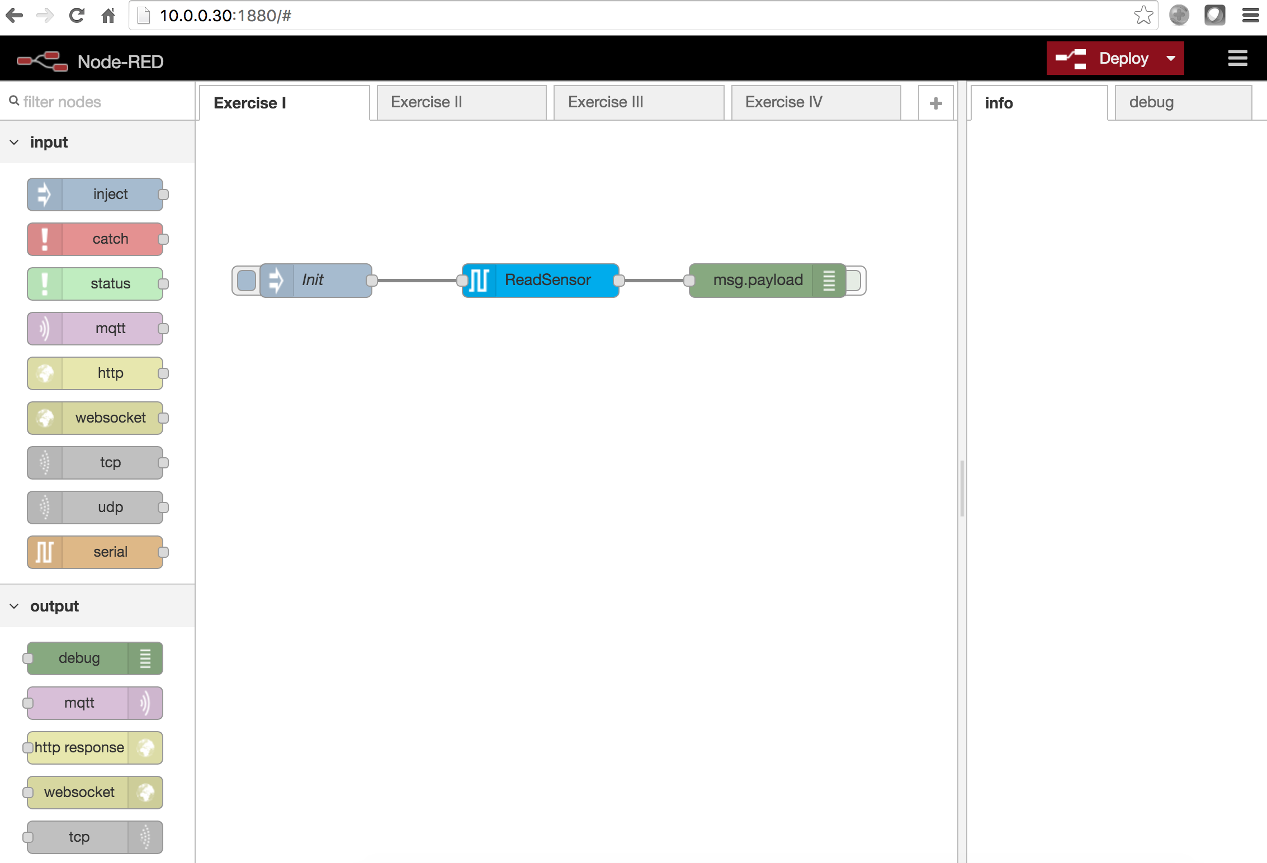
Node-RED
A visual tool for wiring the internet of things, based on Node.js
Utilizes flow programming technique
Construct program flow by drag-and-drop
You have the option not to write code
Growing ecosystem
Cloud-based solutions: IBM Bluemix, Front end Node-RED

Slide 36
Native Development
C/C++: Most popular programming languages for embedded devices. e.g, ARTIK SDK
Python: Rich libraries
JS: Node.js is the most popular JavaScript runtime for high-end IoT devices.
Java: used in projects like Eclipse Kura, Eclipse Milo
Notes:
JS: Node-RED, proxy hub
Java projects: Eclipse Milo, Kura; Real-time Java

Slide 37





3rd party Libraries/Frameworks/Open Source projects
Multimedia: PyAudio, Speech Recognition, OpenCV for computer vision etc.
Connectivity: wpa_supplicant, bluez
Communication Protocols/Frameworks:
- MQTT(Eclipse Mosquitto/Paho)
- CoAP (Eclipse Californium)
- LWM2M(Eclipse Wakama, Eclipse Leshan)
- OPC-UA(Eclipse Milo, open62541)
- IoTivity

Slide 38




3rd party Gateway Solutions
AWS Greengrass
Microsoft IoT Edge
Eclipse Kura
Edge Foundry

Slide 39








Multi Clouds Support
Notes:
Our end-to-end solution has a modular design. You can choose to use the whole solution, or part of it. E.g, you can use our module and stream
This type of universal framework enables interoperability across devices, applications, and operating systems . Instead of building integration from the ground up, you should use these existing frameworks/standards.
Supporting the open standard, frameworks and solutions on the device side help us

Slide 40
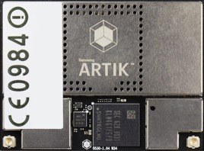
Samsung ARTIK™ 530/s SoMs Competitive advantages
Fully integrated, production ready SoM: Quad Core AP, Secure Element, RAM, Flash, PMIC, passives Multimedia capabilities – 3D graphics acceleration Fully certified – FCC, CE, IC, KC
S-module security features: secure boot, secure OS, secure storage, secure communication, KMS, PKI
Out of the box integration to SmartThings Cloud
E2E Solution:
Tools: Eclipse IDE, GNU toolchain
SoMs

Slide 41
ARTIK Gateway Module
Security
Confidential

Slide 42
Security Questionnaire How do you provide security across all attack surfaces?
Question | ARTIK 5/7/053
Do you support secure communication from device to device or device to cloud? How do you secure communication? Are you using TLS1.2 or higher? | Yes, HTTPs using TLS 1.2
How do you establish identity of device? | Using unique certificate on each device
How does the device establish identity of cloud? | Both device and cloud are chained to ARTIK Root CA and can verify each other certificates
Do you have mutual authentication when enabling secure communication? | Yes
Do you have the infrastructure to inject unique key and certificate in each device to establish unique identity per device? How much does it cost? | Yes (Done at Samsung factory. Cost included in module)
How do you protect your certificate, keys? Are your certificate and keys safe if software is hacked? | Specialized HW on module (secure element)
Is your certificate infrastructure secure? How do you secure your Root Certificates? How much does it cost? | Yes (Root CA secured by 3rd party security vendor)
How do you guarantee your firmware integrity? | Secure Boot

Slide 43
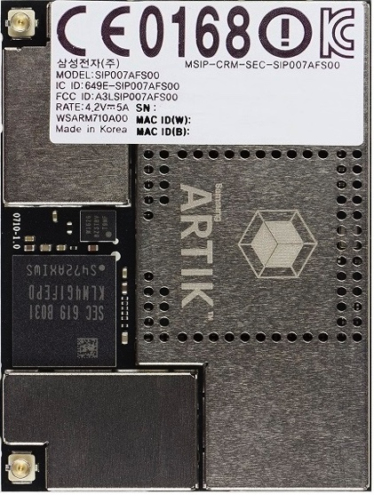
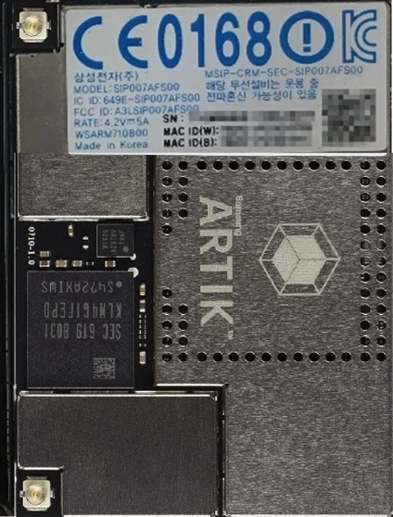
Non-S vs. S Modules
Same HW specifications other than security features
"s" type modules can be identified by blue labeling
Standard module
“S” module

Slide 44
Samsung ARTIK™ S-Module Features
 |  | ARTIK module (05x, 5, 7) | ARTIK S-module | Comments
Secure communication | Per device unique key & certificate | ✓ | ✓ | Uniquely identifies device
 | Key stored in HW secure element | ✓ | ✓ | Secure key storage
 | PKI infrastructure: Mutual authentication of device and cloud | ✓ | ✓ | Device talks to authorized cloud and vice versa
 | Post Provisioning |  | ✓ | Provision with your own keys and certificates
Device protection/ secure code execution | KMS infrastructure for code signing |  | ✓ | Key Management Service
 | Code verification key in HW |  | ✓ | Secure key storage
 | Secure boot (check for authorized code) |  | ✓ | Boot image verification
 | JTAG access locked |  | ✓ | Lock out debug access
Data protection/ Secure storage | Secure OS (separate normal & secure operations) |  | ✓ | Hardware enforced secure applications via TEE
 | Security Lib API (27 API calls) | Limited(random number generator, get cert and signature) | ✓ | Key Manager, Authentication, Secure Storage, Post Provisioning, Encrypt/Decrypt
 | Secure storage |  | ✓ | Encrypt data stored on Flash
Notes:
Post Provisioning APIs vs. Secure Storage APIs???

Slide 45








Encryption
Plaintext
Ciphertext
Plaintext
Encrypt
Decrypt
Cloud’s public key
Cloud’s private key
Different keys are used to encrypt and decrypt messages

Slide 46
Authentication
Signed data
Module A’s private key
Module A’s public key

Slide 47
ARTIK PKI
A Public Key Infrastructure (PKI) supports the distribution and identification of public encryption keys, establishing authenticity and trust in a system.
ARTIK provides its own PKI, which is used to generate and apply unique certificates and key pairs to each ARTIK Module during manufacturing.
PKI’s core concept is (Digital) Certificate. Issued by a Certificate Authority, e.g, GlobalSign, Symantec
ARTIK Root CA
…
…
Mqtt endpoint …
REST endpoint

Slide 48
Mutual Authentication
Each ARTIK module is provisioned with:
An unique private key
Its associated certificate containing a public version of the key.
An ARTIK Root CA certificate
ARTIK Cloud’s server certificate is also rooted to the ARTIK Root CA certificate
At connect time, server and client exchange certificates for mutual authentication
Notes:
An ARTIK Root CA certificate that can verify your module certificate.
ARTIK Cloud and devices use Transport Layer Security (TLS) and Datagram TLS (DTLS) protocols for a secure communication channels. Over TLS/DTLS, ARTIK Cloud authenticates ARTIK devices using a certificate/key-pair stored on each ARTIK device. The certificate/key-pair cannot be altered or tampered with once they have been flashed onto the ARTIK device.
Also, as part of the authentication process, matching session keys are created to establish a secure session for data transfer between the ARTIK device and ARTIK Cloud, which are then used to encrypt/decrypt the traffic.

Slide 49
Post Provisioning
If you want to connect your ARTIK Module to a 3rd party Cloud service or implement a link between ARTIK modules, you need to generate your own certificate/key-pair
We can use Post Provisioning to post provision customer credentials(key, certificate) to Secure Element
Notes:
One may also store an HMAC key(keyed hash message authentication code) and asymmetric key pair into secure storage. This may be used to set up a secure connection with a third party cloud service.

Slide 50
SSL/TLS/DTLS
Transport Layer Security(TLS) and its predecessor, Secure Socket Layer(SSL) are cryptographic protocols designed to provide communication security.
Use X.509 certificates(asymmetric) cryptography to authenticate the counterparty
Negotiate a symmetric session key, which is to be used for data encryption
DTLS is an implementation of TLS over UDP

Slide 51
Secure Communication
ARTIK Modules support:
A unique pair of key and cert from ARTIK PKI
True random number generator
Cryptographic Accelerator, Encoding and decoding of packages
TLS/DTLS library for creating the channel
OpenSSL Engine which takes advantage of the hardware accelerated ARTIK security library to get keys from the secure element, encrypt and decrypt, encode and decode.. (Supported OpenSSL Ciphers: ECB, CBC, CTR etc.)
Notes:
True random number generator is used to generate random cryptographic keys.
CBC(Cipher Blocker Chaining) is an advanced form of block cipher encryption. With CBC mode encryption, each ciphertext block is dependent on all plaintext block processed up to that point. This adds an extra level of complexity to the encrypted data.
CTR is used if you want to good parallelization.

Slide 52
Secure Communication
 |  | ARTIK module (05x, 5, 7) | ARTIK S-module (053s, 055s, 530s, 710s) | Comments
Secure communication | Per device unique key & certificate | ✓ | ✓ | Uniquely identifies device
 | Key stored in HW secure element | ✓ | ✓ | Secure key storage
 | PKI infrastructure: Mutual authentication of device and cloud | ✓ | ✓ | Device talks to authorized cloud and vice versa
 | Post Provisioning |  | ✓ | Provision with your own keys and certificates
Device protection/ secure code execution | KMS infrastructure for code signing |  | ✓ | Key Management Service
 | Code verification key in HW |  | ✓ | Secure key storage
 | Secure boot (check for authorized code) |  | ✓ | Boot image verification
 | JTAG access locked |  | ✓ | Lock out debug access
Data protection/ Secure storage | Secure OS (separate normal & secure operations) |  | ✓ | Hardware enforced secure applications via TEE
 | Security Lib API (27 API calls) | Limited(random number generator, get cert and signature) | ✓ | Key Manager, Authentication, Secure Storage, Post Provisioning, Encrypt/Decrypt
 | Secure storage |  | ✓ | Encrypt data stored on Flash

Slide 53
Secure Boot
Secure Boot adds cryptographic checks to each stage of the boot process.
The first element in the boot process authenticates the second, the second verifies the third.
Authentication is based on digital signature verification.
Chain of Trust: Every component can be authenticated before being executed.
Notes:
Secure boot process implements a chain of trust. Every component can be authenticated before being executed. The ownership of the chain can change at each stage.
e.g, A public key that belongs to the device OEM can be used to authenticate the first bootloader. First bootloader authenticates and loads the 2nd bootloader, 2nd bootloader loads and authenticates os..
Secure Boot works like a security gate. Code with valid credentials gets through the gate and executes. However, Secure Boot blocks at the gate and rejects a code that has bad credentials, or no credential.

Slide 54
Secure Boot for ARTIK S-Module
Signed with Secure Boot Key
ROM code
BL1 Binary
BL0
Customer’s Public Key
u-Boot Binary
OS Binary
e-fuse
Signature
Signature
Signature
Samsung Secure Boot Key
Sign Hash (BL1 raw binary and customer’s public key)
Sign Hash (u-boot raw binary) with customer’s private key
Sign Hash (OS binary) with customer’s private key
BL0:
1. Decrypt BL1
2. Verify signature using BL1 Hash(BL1
binary and customer’s public key) and hash
BL1:
1. Verify signature using u-boot Hash (u-boot binary and customer’s public key)
2. Load to DRAM
u-boot:
1. Verify signature using (OS binary and customer’s public key)
2. Load to DRAM
Notes:
build/configs/artik05x/bin
ROM code = Root of Trust
Need to store the public keys which will be used to decrypt the signature of the bootloader and make it tamper-proof.
OTP fuse is silicon expensive. Public key is at least 1KB. It is less expensive to store only the hash of the public key, then compare it to the hash of the public key embedded in a given binary.
Public key encryption is not efficient. In practice, instead of encrypting the entire message to create the signature, messages are hashed and then encrypted with the private key. Since hashes are the same size regardless of the length of the original message, performance is better.

Slide 55
Key Management System
Signing keys are stored and operated within FIPS 140-2 certified Hardware security modules (HSM)
Images are signed through a highly secure cryptography standard (SHA-256 w/ RSA2048 encryption)
Strict access control policies
Only accessible through whitelisted IP addresses
Notes:
Key Management System(KMS) is used for the production signing process.
KMS – manage crypto keys in a cryptosystem.
This includes dealing with the generation, distribution, exchange, storage, use, and replacement of keys. All aspects of security should be covered for the life-cycle of a key, from key generation to replacement, storage, or disposal. Each key must also be protected during its life-time to prevent unauthorized disclosure, modification, substitution, replay, and improper use. Likewise, the functions used in key management must be prevented from such unauthorized use.
Samsung’s KMS is supported by Thales’ cryptographic solutions to provide cryptographic key generation, verification, signing and key management.
Federal Information Processing System 140-2, is a US government standard used to accredit crypto modules.
SHA-256 is a member of the SHA2 family of secure hash functions, and there are not currently any cryptographic weaknesses publicly known for SHA2. It might be less secure than SHA-512, but 256 bits is already completely impractical to brute force (we're talking about timeframes of hundreds of years even with the resources of a nation-state and assuming Moore's Law continues on track, or billions of years for currently-established technology). The only viable attacks would require finding a weakness in the hash algorithm itself, and it's not necessarily the case that SHA-512 would be more resistant to such an attack than SHA-256. There is a newSHA3 standard, but it's not yet widely implemented so your browser probably wouldn't be able to verify the certificate's signature at all if they used SHA3 in the signing algorithm.
RSA is a current standard for public-key cryptography, and a properly-generated 2048-bit RSA key is strong enough to resist factoring for decades. You could use a 4096-bit key if you want to (it'll take a lot longer to generate, and slightly longer to use, but once the certificate's signature is verified that doesn't matter anymore), and that would take even longer to break. However, neither certificate is valid for more than two years anyhow. If you want a signature you can trust for 30 years or more, you might want to use something stronger than 2048-bit RSA, but for now that's fine.

Slide 56

Samsung ARTIK™ Key Management System(KMS) Code signing portal manages key signing
NEW
Device maker
Develops application
Device maker generates their own key and sends code to portal for signature
Device maker deploys code, enables Secure Boot
Device maker downloads signed code
ARTIK S-module
Samsung KMS

Slide 57
Device Protection
 |  | ARTIK module (05x, 5, 7) | ARTIK S-module (053s, 055s, 530s, 710s) | Comments
Secure communication | Per device unique key & certificate | ✓ | ✓ | Uniquely identifies device
 | Key stored in HW secure element | ✓ | ✓ | Secure key storage
 | PKI infrastructure: Mutual authentication of device and cloud | ✓ | ✓ | Device talks to authorized cloud and vice versa
 | Post Provisioning |  | ✓ | Provision with your own keys and certificates
Device protection/ secure code execution | KMS infrastructure for code signing |  | ✓ | Key Management Service
 | Code verification key in HW |  | ✓ | Secure key storage
 | Secure boot (check for authorized code) |  | ✓ | Boot image verification
 | JTAG access locked |  | ✓ | Lock out debug access
Data protection/ Secure storage | Secure OS (separate normal & secure operations) |  | ✓ | Hardware enforced secure applications via TEE
 | Security Lib API (27 API calls) | Limited(random number generator, get cert and signature) | ✓ | Key Manager, Authentication, Secure Storage, Post Provisioning, Encrypt/Decrypt
 | Secure storage |  | ✓ | Encrypt data stored on Flash

Slide 58
Trusted Execution Environment on 5/7x (TEE)
Normal Execution Environment
Trusted Execution Environment
Normal CPU
Trusted CPU
Normal
Memory
Normal Peripherals
Trusted
Memory
Trusted Peripherals
ARTIK 5 and 7 module families support Trusted Execution Environment(TEE)
Samsung TEE implementation is based on ARM TrustZone hardware architecture
TEE provides a fully-isolated and secured operation environment

Slide 59
Secure Storage – eMMC file system
eMMC file system (Flash-based)
Uses the same storage as the normal operating system. However, a specific partition is managed by Secure OS.
All data in this partition is encrypted with a unique key generated at run time, and is stored as a file unit of 32KB with a maximum of 1024 files that may be stored.
Applies to ARTIK 05x and 5/7 modules.

Slide 60
Secure Storage – Secure Element
Secure Element – an isolated storage device that supports 2 slots of ECDSA key pairs (16 AES 128-bit keys).
The Secure Element provides high levels of security as hardware with anti-tamper measures.
It includes cryptographic services such as random-number generation, key/data secure storage, and certificates handling and processing.
All communication from the Secure Element to the processor is secured and encrypted.
Uses Power glitch detector, Active Shield removal detector etc. technologies to achieve the highest level of security and protection.
The Secure Element meets the Common Criteria (CC) certification for security and for Evaluation Assurance Level (EAL) 5.
Notes:
When physical attack is detected, secure element deletes stored data.

Slide 61
ARTIK SEE Architecture
Normal OS
Application
Application
…
Application
Security API
Trusted
Secure OS
Authentication
Enc/Dec
Key Manager
Secure Storage
Encryption and decryption with Secured key
…
Generate
Delete
Protect
Key
Certificate
Other data
eMMC specific partition
Secure Storage
Notes:
Works on RTOS.
Samsung SEE: Samsung Secure Execution Environment (SEE) environment supports the implementation of basic security APIs for key generation and storage, certificate handling, and provides secured access to the secure storage and its services described later in the document. The SEE environment includes all the key and certification security services required for the implementation of full access to ARTIK Cloud.
a. Key Manager: Provides APIs to generate, setup, and remove keys
b. Certificate Manager: Provides APIs to generate, manage, and verify certificates and signatures
c. Crypto Manager: Provides APIs for AES and RSA encryption and decryption
d. Secure Storage Manager: Provides APIs for initializing and managing the secure storage
e. Post Provision: Provides APIs for injecting and provisioning a certificate and key into Secure Element

Slide 62
Device Protection
 |  | ARTIK module (05x, 5, 7) | ARTIK S-module (053s, 055s, 530s, 710s) | Comments
Secure communication | Per device unique key & certificate | ✓ | ✓ | Uniquely identifies device
 | Key stored in HW secure element | ✓ | ✓ | Secure key storage
 | PKI infrastructure: Mutual authentication of device and cloud | ✓ | ✓ | Device talks to authorized cloud and vice versa
 | Post Provisioning |  | ✓ | Provision with your own keys and certificates
Device protection/ secure code execution | KMS infrastructure for code signing |  | ✓ | Key Management Service
 | Code verification key in HW |  | ✓ | Secure key storage
 | Secure boot (check for authorized code) |  | ✓ | Boot image verification
 | JTAG access locked |  | ✓ | Lock out debug access
Data protection/ Secure storage | Secure OS (separate normal & secure operations) |  | ✓ | Hardware enforced secure applications via TEE
 | Security Lib API (27 API calls) | Limited(random number generator, get cert and signature) | ✓ | Key Manager, Authentication, Secure Storage, Post Provisioning, Encrypt/Decrypt
 | Secure storage |  | ✓ | Encrypt data stored on Flash

Slide 63
Platform Security

Slide 64




Samsung ARTIK™ End-to-end Platform Security End-to-end protection for you and your customers
ARTIK Modules
SmartThings Cloud
Mobile apps
Public key
infrastructure
Mutual Authentication
Encrypted Communication
OAuth
authorization
Password protection
Secure boot
Prevents unauthorized software from booting and running on device
Secure OS
Hardware-enforced secure applications
Secure storage
Data encryption
Authentication and authorization, Secure OTA
Cloud services are protected
User data encryption
Protects sensitive info on mobile devices
Notes:
End-to-end security begins when an ARTIK device is turned on. Security services on ARTIK modules guarantee that only authorized software is loaded and runs on the device.
As the device connects to ARTIK Cloud, public key infrastructure services guarantee that devices log on to the right cloud and the cloud can guarantee that it is working the right devices.
We have spent hundreds of thousands of person-hours implementing this level of integrated security.
To do it yourself, with other modules, cloud services, and applications is complicated, expensive, and risky.
Mobile applications can also work securely with the cloud, protecting passwords and use data on the mobile device.
Secure Device Registration: ARTIK Cloud services support secure device registration for communicating securely to devices.
The device is genuine
Every message exchanged between the device and ARTIK cloud services is verified
Use TLS for mutual client/server authentication
Secure OTA:

Slide 65
Samsung ARTIK™ End-to-end Platform Security*
 | Feature | ARTIK
Modules | Secure element key storage, secure boot | ✔ Included
 | Security infrastructure: PKI and KMS | ✔ Included
 | Unique device ID and certificate | ✔ Included
 | Secure data storage with data encryption | ✔ Included
Platform software | Secure device registration | ✔ Included
 | Secure OTA updates | ✔ Included
Cloud Infrastructure | Supports HIPAA compliant solutions | ✔ Included
 | OWASP top 10 | ✔ Included
 | Internal and external security audits | ✔ Included
Cloud services | AAA (Authentication, Authorization, Accounting) | ✔ Included
 | API Security | ✔ Included
 | 3rd party device discovery and mutual authentication | ✔ Included
 | Data privacy management, identity, permissions, | ✔ Included
Communications | TLS, VPN | ✔ Included
 | DTLS Application level security; BLE session security | ✔ Included
Applications | Key and secure app data encryption and storage | ✔ Included
 | 2-factor authentication; OAuth2; client side certificates | ✔ Included
* Feature list is not exhaustive
Notes:
OAuth2

Slide 66
Samsung ARTIK™ Helpful web resources
Web Documentation https://developer.artik.io/documentation/ Document Library https://www.artik.io/library/ Forums https://developer.artik.io/forums/ Blog https://www.artik.io/blog/ File Tickets https://support.artik.io Github Repository https://github.com/SamsungARTIK YouTube Channel https://www.youtube.com/channel/UC4rolvSm8ikmnymdbbznNJw
Notes:
Samsung ARTIK Modules
Samsung ARTIK has a complete family of production-ready, system-on-modules suitable for everything from battery-powered devices and edge nodes to gateways and hubs to high-end, high-value hardware products.
All ARTIK modules are tightly integrated with ARTIK cloud platform and security features to speed deployment and protect your business.
What does “production ready” really mean?
It means you can count on production quality and scalable volumes. Wireless radio functionality is pre-certified and supports industry-standard protocols (Wi-Fi, Bluetooth, Zigbee, and Thread).
It means networking, connectivity, multimedia and other middleware stacks are pre-integrated and fully tested. ARTIK includes development environment, SDKs, APIs, and starter kits.
It means access to an ARTIK technical support team, not just online forums and developer sites.

Slide 67
ARTIK Training Tues
Confidential

Slide 68
Samsung ARTIK™ Training Tues
2-hour training sessions every other Tues starting from Aug, 14th
Level 1: ARTIK Fundamentals (Lecture with interactive exercises. No ARTIK hardware is required)
L1_1: ARTIK Intro: ARTIK Intro and guide audience through online resources
L1_2: Cloud Communication
Level 2: ARTIK HW/SW Features (Lecture + hands-on)
L2_1: ARTIK System Design, ARTIK 05x Overview
L2_2: ARTIK Security
L2_3: ARTIK HW Interfaces
L2_4: ARTIK Connectivity
Level 3: ARTIK Applications and Solutions (mostly hands-on. )
L3_1: Getting Started with Machine Learning Inference on ARTIK(5x hands-on)
L3_2: Build a Google Assistant/AVS voice-enabled gateway(5x hands-on)
Notes:
End-to-end security begins when an ARTIK device is turned on. Security services on ARTIK modules guarantee that only authorized software is loaded and runs on the device.
As the device connects to ARTIK Cloud, public key infrastructure services guarantee that devices log on to the right cloud and the cloud can guarantee that it is working the right devices.
We have spent hundreds of thousands of person-hours implementing this level of integrated security.
To do it yourself, with other modules, cloud services, and applications is complicated, expensive, and risky.
Mobile applications can also work securely with the cloud, protecting passwords and use data on the mobile device.
Secure Device Registration: ARTIK Cloud services support secure device registration for communicating securely to devices.
The device is genuine
Every message exchanged between the device and ARTIK cloud services is verified
Use TLS for mutual client/server authentication
Secure OTA:

Slide 69
2018
 | January |  |  |  |  |  |  |  | February |  |  |  |  |  |  |  |  |  | March |  |  |  |  |  |  |  | April
 | S | M | T | W | T | F | S |  | S | M | T | W | T |  | F | S |  |  | S | M | T | W | T | F | S |  | S | M | T | W | T | F | S
 |  | 1 | 2 | 3 | 4 | 5 | 6 |  |  |  |  |  | 1 |  | 2 | 3 |  |  |  |  |  |  | 1 | 2 | 3 |  | 1 | 2 | 3 | 4 | 5 | 6 | 7
 | 7 | 8 | 9 | 10 | 11 | 12 | 13 |  | 4 | 5 | 6 | 7 | 8 |  | 9 | 10 |  |  | 4 | 5 | 6 | 7 | 8 | 9 | 10 |  | 8 | 9 | 10 | 11 | 12 | 13 | 14
 | 14 | 15 | 16 | 17 | 18 | 19 | 20 |  | 11 | 12 | 13 | 14 | 15 |  | 16 | 17 |  |  | 11 | 12 | 13 | 14 | 15 | 16 | 17 |  | 15 | 16 | 17 | 18 | 19 | 20 | 21
 | 21 | 22 | 23 | 24 | 25 | 26 | 27 |  | 18 | 19 | 20 | 21 | 22 |  | 23 | 24 |  |  | 18 | 19 | 20 | 21 | 22 | 23 | 24 |  | 22 | 23 | 24 | 25 | 26 | 27 | 28
 | 28 | 29 | 30 | 31 |  |  |  |  | 25 | 26 | 27 | 28 |  |  |  |  |  |  | 25 | 26 | 27 | 28 | 29 | 30 | 31 |  | 29 | 30
 | May |  |  |  |  |  |  |  | June |  |  |  |  |  |  |  |  |  | July |  |  |  |  |  |  |  | August
 | S | M | T | W | T | F | S |  | S | M | T | W | T |  | F | S |  |  | S | M | T | W | T | F | S |  | S | M | T | W | T | F | S
 |  |  | 1 | 2 | 3 | 4 | 5 |  |  |  |  |  |  |  | 1 | 2 |  |  | 1 | 2 | 3 | 4 | 5 | 6 | 7 |  |  |  |  | 1 | 2 | 3 | 4
 | 6 | 7 | 8 | 9 | 10 | 11 | 12 |  | 3 | 4 | 5 | 6 | 7 |  | 8 | 9 |  |  | 8 | 9 | 10 | 11 | 12 | 13 | 14 |  | 5 | 6 | 7 | 8 | 9 | 10 | 11
 | 13 | 14 | 15 | 16 | 17 | 18 | 19 |  | 10 | 11 | 12 | 13 | 14 |  | 15 | 16 |  |  | 15 | 16 | 17 | 18 | 19 | 20 | 21 |  | 12 | 13 | 14 | 15 | 16 | 17 | 18
 | 20 | 21 | 22 | 23 | 24 | 25 | 26 |  | 17 | 18 | 19 | 20 | 21 |  | 22 | 23 |  |  | 22 | 23 | 24 | 25 | 26 | 27 | 28 |  | 19 | 20 | 21 | 22 | 23 | 24 | 25
 | 27 | 28 | 29 | 30 | 31 |  |  |  | 24 | 25 | 26 | 27 | 28 |  | 29 | 30 |  |  | 29 | 30 | 31 |  |  |  |  |  | 26 | 27 | 28 | 29 | 30 | 31
 | September |  |  |  |  |  |  |  | October |  |  |  |  |  |  |  |  |  | November |  |  |  |  |  |  |  | December
 | S | M | T | W | T | F | S |  | S | M | T | W | T |  | F | S |  |  | S | M | T | W | T | F | S |  | S | M | T | W | T | F | S
 |  |  |  |  |  |  | 1 |  |  | 1 | 2 | 3 | 4 |  | 5 | 6 |  |  |  |  |  |  | 1 | 2 | 3 |  |  |  |  |  |  |  | 1
 | 2 | 3 | 4 | 5 | 6 | 7 | 8 |  | 7 | 8 | 9 | 10 | 11 |  | 12 | 13 |  |  | 4 | 5 | 6 | 7 | 8 | 9 | 10 |  | 2 | 3 | 4 | 5 | 6 | 7 | 8
 | 9 | 10 | 11 | 12 | 13 | 14 | 15 |  | 14 | 15 | 16 | 17 | 18 |  | 19 | 20 |  |  | 11 | 12 | 13 | 14 | 15 | 16 | 17 |  | 9 | 10 | 11 | 12 | 13 | 14 | 15
 | 16 | 17 | 18 | 19 | 20 | 21 | 22 |  | 21 | 22 | 23 | 24 | 25 |  | 26 | 27 |  |  | 18 | 19 | 20 | 21 | 22 | 23 | 24 |  | 16 | 17 | 18 | 19 | 20 | 21 | 22
 | 23 | 24 | 25 | 26 | 27 | 28 | 29 |  | 28 | 29 | 30 | 31 |  |  |  |  |  |  | 25 | 26 | 27 | 28 | 29 | 30 |  |  | 23 | 24 | 25 | 26 | 27 | 28 | 29
 | 30 |  |  |  |  |  |  |  |  |  |  |  |  |  |  |  |  |  |  |  |  |  |  |  |  |  | 30 | 31
 |  |  |  | Level 1 |  |  |  |  |  |  |  | Level 2 |  |  |  |  |  |  |  |  |  | Level 3
 | Date |  |  |  |  |  |  |  |  | Topics
 | Oct 9th |  |  |  |  |  |  |  |  | Level 1 –ARTIK Intro
 | Oct 23rd |  |  |  |  |  |  |  |  | Level 2- ARTIK Security
 | Nov 13th |  |  |  |  |  |  |  |  | Level 2- ARTIK Connectivity
 | Nov 27th |  |  |  |  |  |  |  |  | Level 3-Getting Started with Predictive Analysis and Image Classification on ARTIK
 | Dec 11th |  |  |  |  |  |  |  |  | Level 1 – ARTIK Intro(with 310)

